Slide 1
VAFA Interpretations
2021

Slide 2
AREAS OF DISCUSSION
Our Match Day Principles
Things that have changed
  Kick-in from behind
  Runner in Arc at kick-in
  Ruck Contest Nomination
  Throw-In Recall
  Deliberate Rushed Behind
Quick revision

Slide 3
Our Match Day Principles
Blend into the game
Pay Major and Obvious free kicks
Communicate concisely and effectively using language of the laws
Notes:
My mission – to get Deliberate Out Of Bounds out of our vocab.
Can you think of why?
Insufficient Intent!

Slide 4
New Rules & Interpretations
Kick-in from behind
Runner in arc at kick in (free kick location)
Ruck Contest Nomination
Throw-in Recall
Deliberate Rushed Behind interpretation
Stand rule does NOT apply (so please don’t say stand!)
Notes:
Kick in from behind – we’ve done this for a few weeks, quick recap
Runner in the arc at a kick in – the law hasn’t changed, the free kick location has.

Slide 5
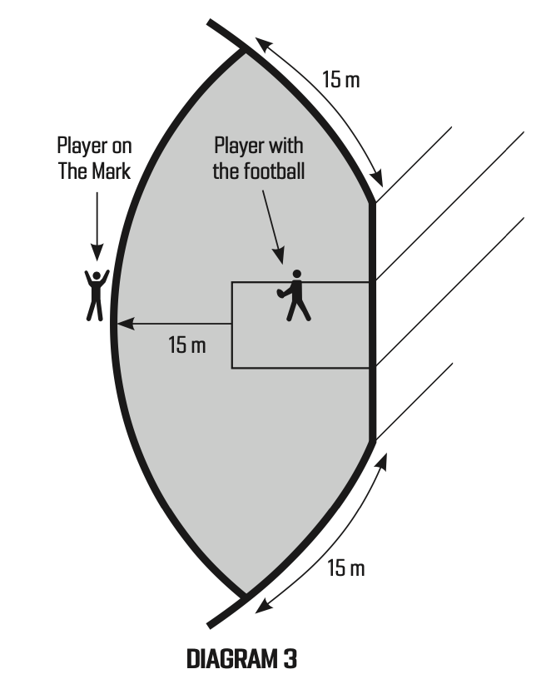
Kick In - Law
All players must use every endeavour to immediately vacate the Protected area
50m penalty against attacking player who:
Is in P.A. when ball is being brought back in and hasn’t made every endeavour
Prevents or attempts to prevent player from bringing into play
Otherwise delays play
Notes:
Note: The players do not have to have successfully leave the protected area prior to the player kicking in or playing on, and once play on called players may run anywhere.
This is no different to the protected area at any set kick around the ground.

Slide 6
Kick In - Interpretation
BOTH teams must endeavour to leave
Once players have left the area, defenders may lead back in. Attacker may follow (2m)
Reset play if defender does not endeavour to leave area (see next slide)
Player now has 10 seconds before whistle up (previously 6-7)
Notes:
Note: Just like all protected area situations, the players do not have to have successfully leave the protected area before the kick is taken.
The kick out from behind does not need to ‘clear’ this area, and can be marked within the protected area.

Slide 7
Kick In - VAFA
MAJOR AND OBVIOUS ONLY
Defenders - Reset only if interferes with play
Attackers – 50m penalty is the same as for other protected area infringements:
Genuine ‘non-endeavour’ particularly where that may delay the kick taker, or
Set up on the line and break early
50m penalty is from the mark – 74m from goal line!!! (centre circle most grounds)
Notes:
We cannot stress the ‘major and obvious’ enough for this rule. If it has to be paid, then pay it. But we’re still looking at the kinds of things that we would have previously paid a 50m for.
Reset only if the defenders gain an advantage by having been in the area when they shouldn’t. Example: If a defender sets up 10m from the goal line, stops, and doesn’t endeavour to move out of the area. If the ball is kicked to them, reset. If the ball is kicked to another player and they don’t interfere – play on.
Attackers – again we are looking for things that do, or may, affect the play. Examples are: breaking the line early to shut down the player, or a player acting to prevent the kicker from taking a fast kick. If it is an exhausted player trying to leave, even slowly, this is sufficient endeavour.

Slide 8
Kick In – Runner in 45m arc
MAJOR AND OBVIOUS ONLY
Same law as before, but kick is no longer taken at nearest edge of center square
Attacking team infringement: 50m penalty from the Mark (74m from goal line)
Defending team infringement: Free kick from Mark (24m from goal line in front)
Proactive management - we’re looking for interference with play / intentionally blocking an area.
Notes:
We are not trying to emphasize this law – simply highlight the free kick location has changed. These are big penalties – MAJOR AND OBVIOUS only.

Slide 9
Throw In - Nominations
Get nominations at every ruck contest.
Be insistent and consistent, and players will quickly adapt.
Ask at least twice – don’t be in a rush. We want to get nominations and have normal ruck contests
‘Lock out’ of a ruck is available
Notes:
Changed approach
Ask for nominations.

Slide 10
Throw In – Over the Back
If a throw-in is uncontestable by the rucks – recall it.
If a throw-in is contestable and touched by a non-ruck before it touches the ground, it is a free kick.
In limited circumstances calling play-on when uncontestable may be the best option, but we should preference a recall.

Slide 11
Deliberate Rushed Behind
Players shall be encouraged to keep the football in play
Free kick against a defending player who intentionally Kicks, Handballs or forces the ball over the scoring line
Greater than 9m from goal line
Within 9m not under immediate physical pressure
Within 9m has had time and space to dispose
From ruck contest hit over on the full
CHANGE: ‘Immediate physical pressure’ and ‘time and space’ is now 3-5 metres
Remember – must be intentional act of player
Notes:
AFL has tweaked the interpretation of this law over the last couple of years, and so we’re bringing ourselves into line, as it aligns with our motto of ‘Major and Obvious’.
We are looking at only intentional acts of the player. A player pushed over the line is NOT DRB.
Outside 9m, we don’t care about pressure. Were they outside 9m, and did they make an intentional act that rushed the behind?
Within 9m, ‘immediate physical pressure’ & ‘has had time and space’, we’re now looking at 3-5m (no longer touching distance).
Ruck contest hit over on the full is ALWAYS intentional act.
‘All Clear’ if player is spoiling an opponent’s mark.

